Slide 1

Smart Bin Ai
Efficient Waste Management Through AI Innovation

Slide 2

The elite
Presented by:
Tanmay Das - 22010105
Abhilash Chowdhury - 22010110
Tazrian Binte Mahfuz - 22010116
Pritom Gupta - 22010134

Slide 3

Content
Introduction
Steps of making
Conclusion
References

Slide 4

Introduction
The smart bin AI is an innovative waste management solution to automate the sorting of waste categories. The project aims to enhance waste management by using an Arduino Uno to differentiate between organic and inorganic waste. It features an ultrasonic sensor that automatically opens the bin's lid when waste is nearby, promoting a touchless experience. A soil moisture sensor measures the moisture content of the waste, helping to identify organic materials, while an infrared (IR) sensor detects the presence of objects above the bin.
Data from these sensors is analysed using machine learning algorithms, which predict the type of waste based on historical data. This innovative approach not only streamlines waste sorting but also improves recycling and composting efforts. Ultimately, the project addresses key challenges in waste management, paving the way for smarter cities and more sustainable practices.

Slide 5
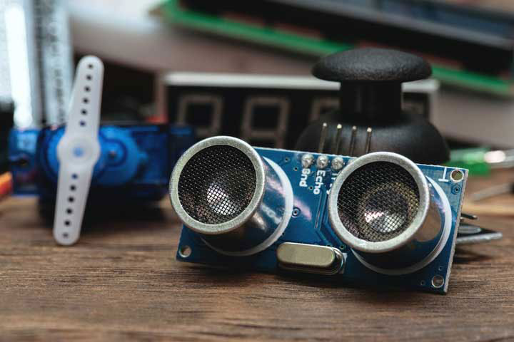

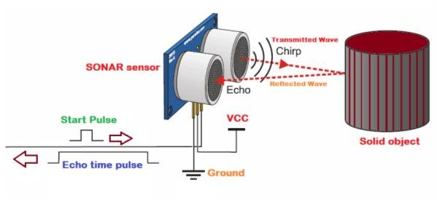
Step of making
Planning and Designing: The planning and design process for the smart bin AI project starts by establishing clear objectives for waste classification and functionality. This is followed by selecting essential components, including sensors and the Arduino Uno. A circuit design is then created to illustrate how the sensors will connect to the Arduino. After planning the hardware setup, the next step involves integrating all components into a cohesive prototype. Finally, through testing is conducted to ensure the system operates accurately and effectively, making necessary adjustments to refine its performance.
Fig: Ultrasonic Sonar Sensor HC-SR04
Fig: Working procedure of ultrasonic sensor

Slide 6
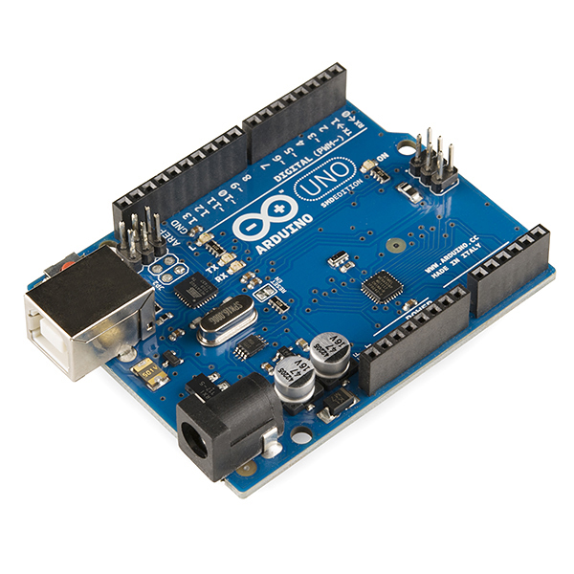
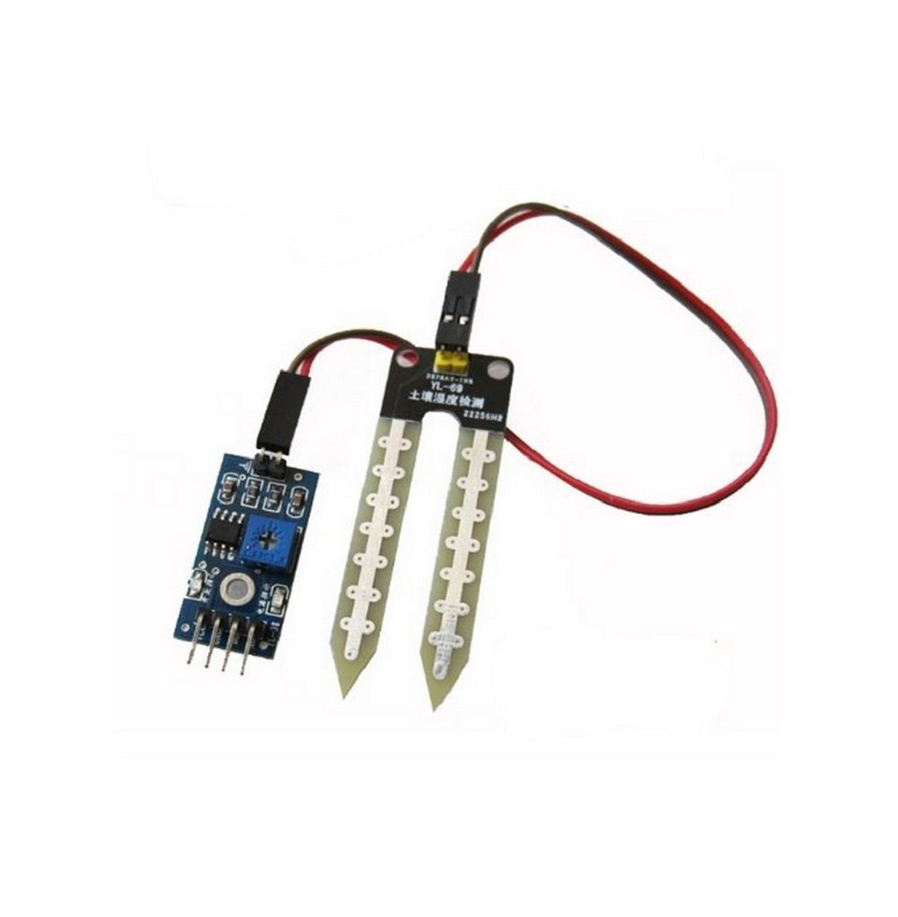
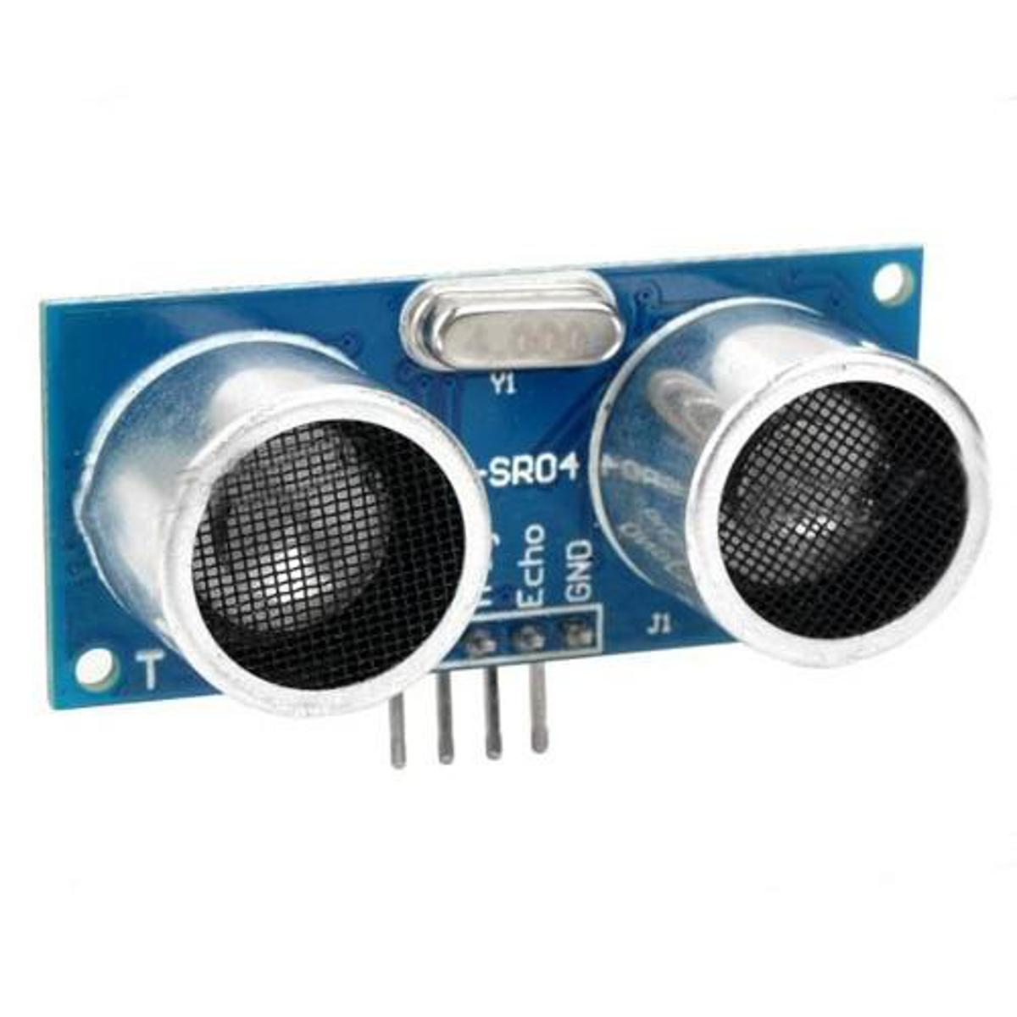
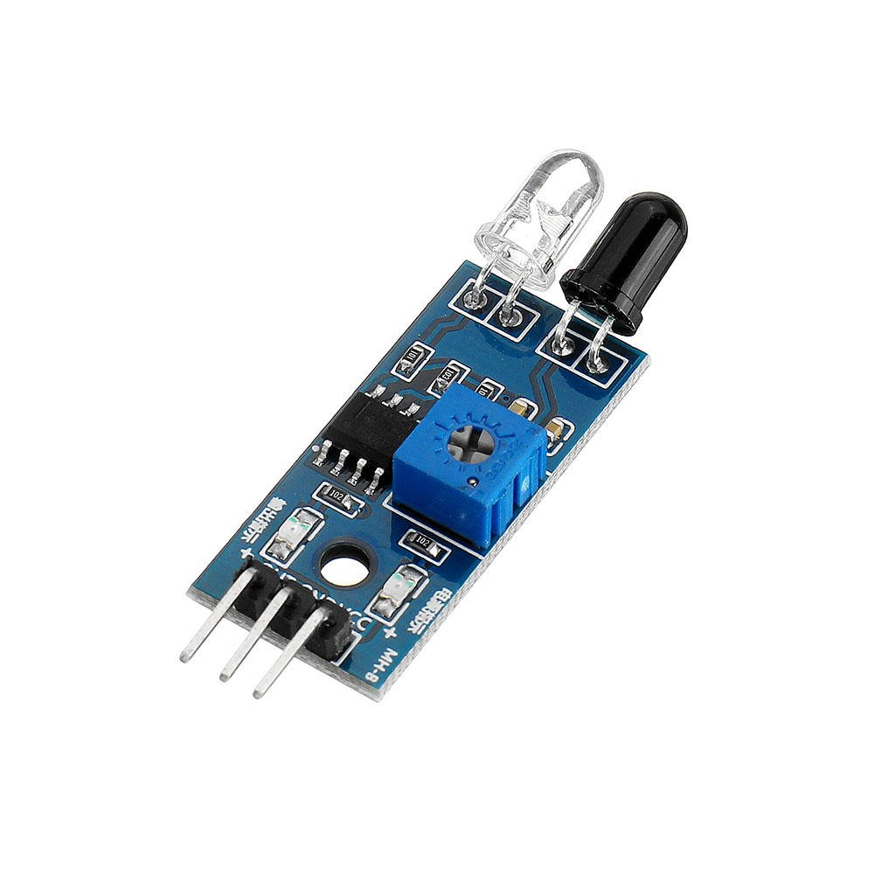
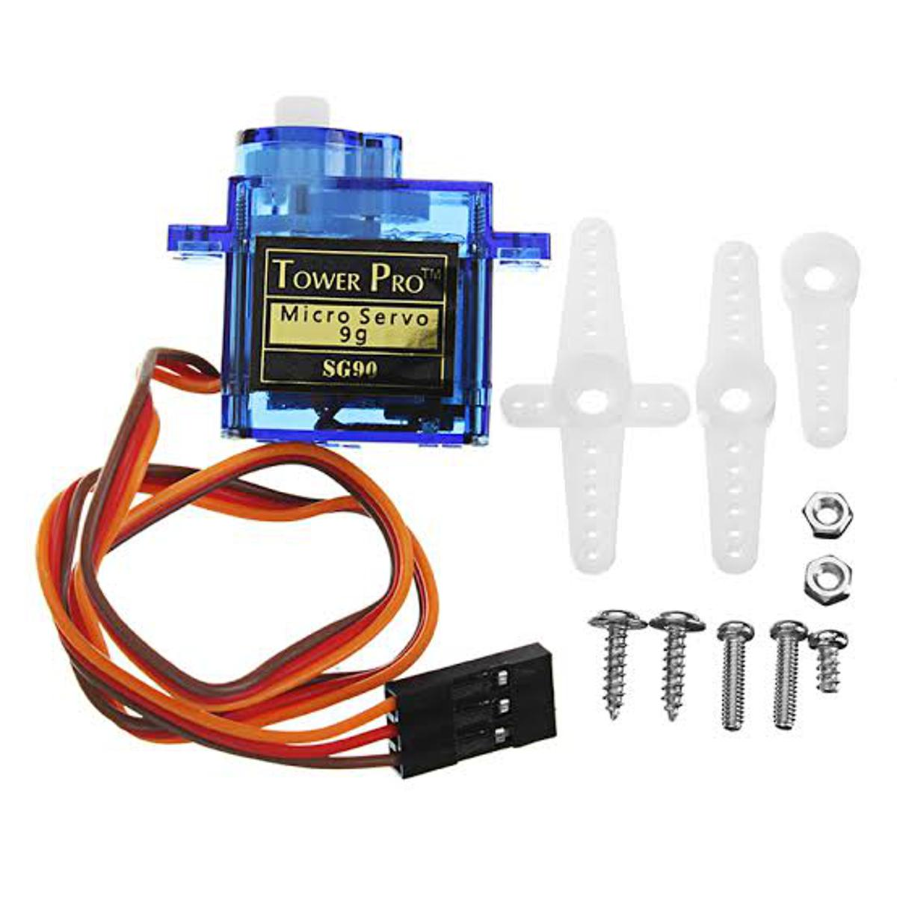
Steps of making
Component Selection :
Arduino Uno (Microcontroller)
YL-69 Soil Hygrometer Humidity & Soil Moisture Detection Sensor
Ultrasonic Sonar Sensor HC-SR04
IR Sensor
SG90 Servo Motor Micro Servo 9G

Slide 7
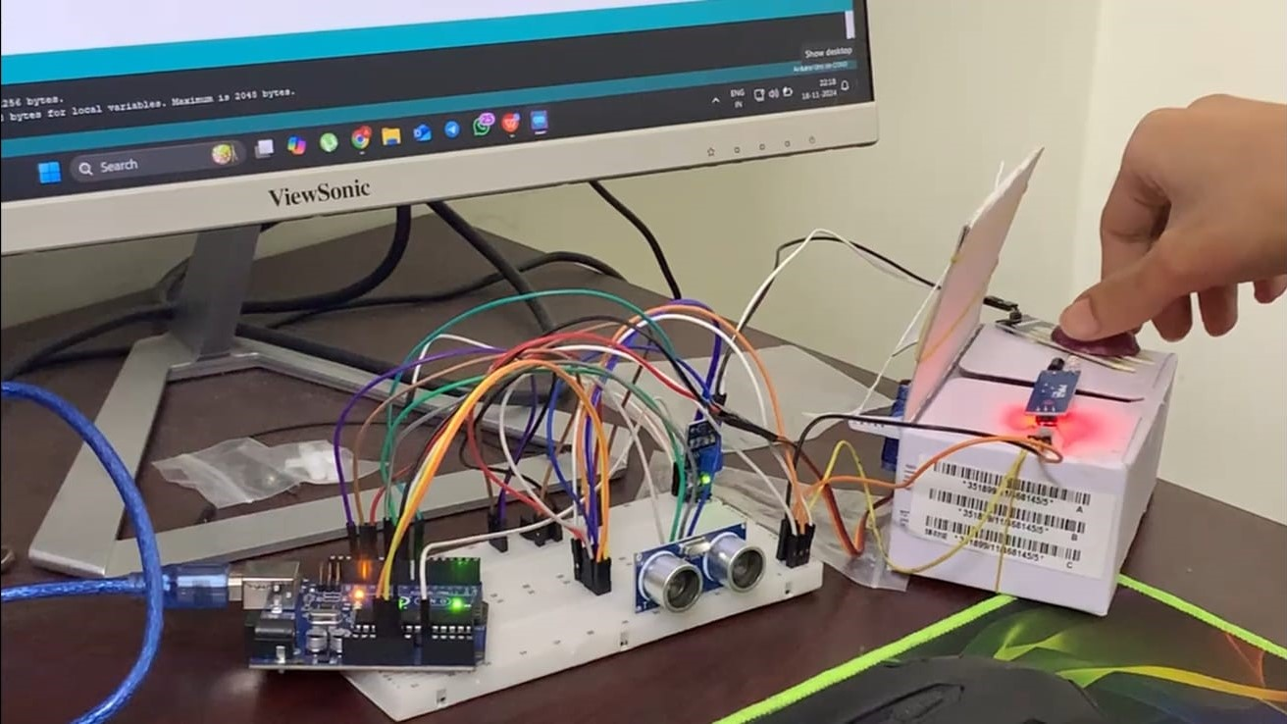
Steps of making
Construction :
Fig: Construction phase of SmartBin AI
The construction of the smart bin AI project involves assembling various hardware components to create an effective waste management system. The primary component is the Arduino Uno, which serves as the control unit. The project includes ultrasonic sensors for detecting nearby objects, a soil moisture sensor to assess the moisture content of waste, and an infrared (IR) sensor for object detection. These components are securely mounted on the bin to ensure accurate readings and functionality.

Slide 8
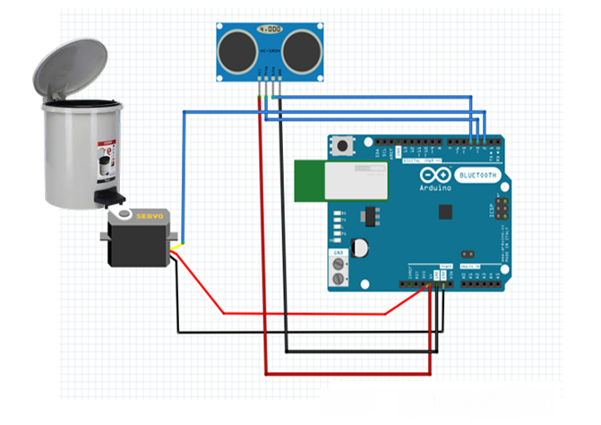
Steps of making
Wiring and Connection :
Wiring and connections are crucial for ensuring proper communication between the components. The ultrasonic sensor is connected to the Arduino using jumper wires, with careful attention to the pin configuration for power, ground, and signal. The soil moisture sensor is similarly wired, ensuring it can relay moisture data effectively. The IR sensor is connected to the Arduino as well, allowing it to detect objects above the bin. All connections should be organized to prevent tangling and ensure ease of troubleshooting.
Fig: Wiring and Connection of Ultrasonic sensor and servo motor with Arduino

Slide 9
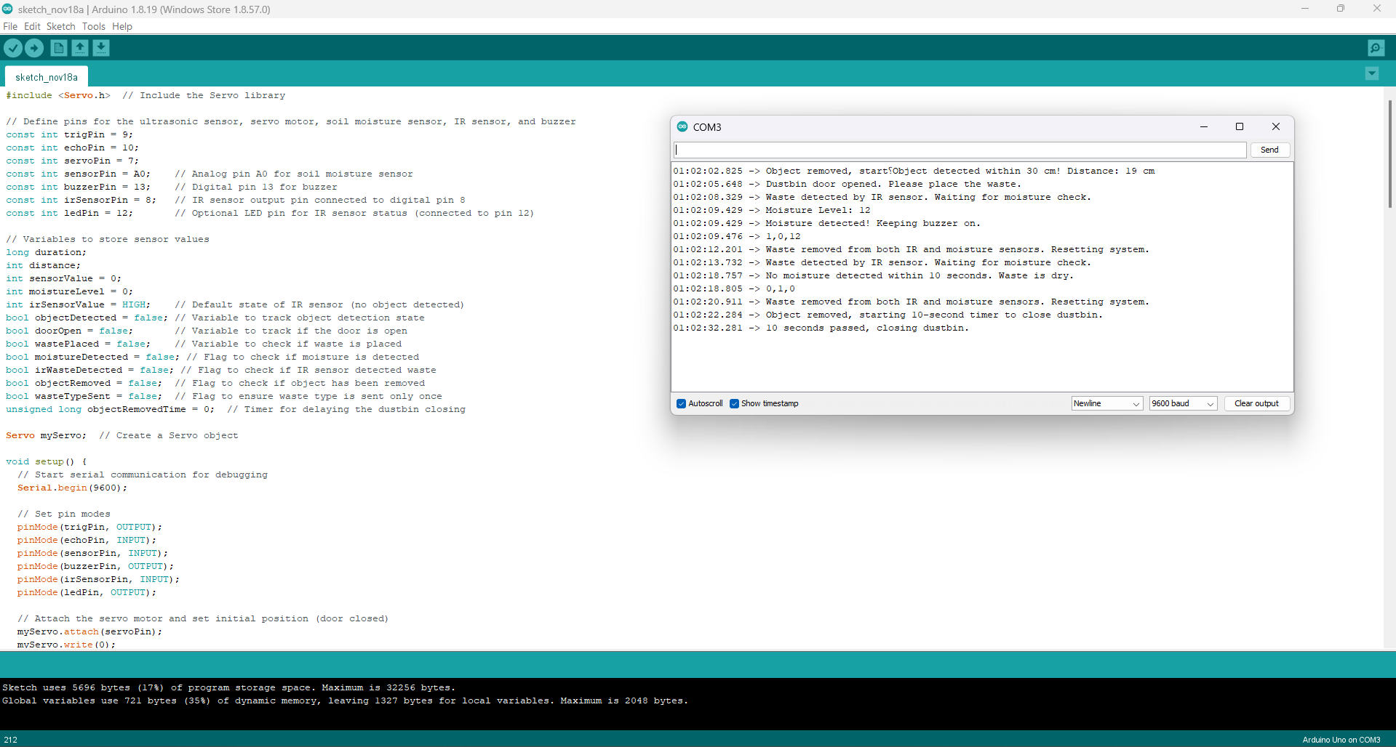
Steps of making
Programming :
Fig: Arduino Code of the project

Slide 10
Steps of making
Testing :
Testing is essential to verify that all components work together as intended. Each sensor is tested individually to ensure accurate readings, followed by testing the entire system to confirm that it correctly identifies waste types and operates the bin lid effectively. Any issues encountered during testing are documented for troubleshooting.
Integration :
Integration involves combining all components into a cohesive unit. After successful testing of individual parts, the entire system is assembled within the smart bin structure. Final adjustments are made based on testing feedback to enhance performance and reliability. This integrated system will then be ready for real-world application in waste management scenarios.

Slide 11

Steps of making
Implementation of AI for Smart Waste Management :
The integration of artificial intelligence (AI) in smart waste management systems represents a significant advancement in how we handle waste disposal and recycling. In our Smart Bin AI project, we utilize machine learning algorithms, specifically employing the Random Forest model, to predict whether waste is organic or inorganic based on data collected from various sensors. This predictive capability enhances the accuracy of waste classification, reducing contamination and improving recycling rates.
By analysing historical data gathered from soil moisture sensors and infrared sensors, the AI system can effectively determine the type of waste being disposed of. This automated classification process not only streamlines waste sorting but also optimizes collection routes and schedules, leading to more efficient resource allocation.
Moreover, the application of AI in this context fosters a more sustainable approach to waste management by minimizing landfill contributions and promoting the recycling of materials. The use of advanced data analytics allows for real-time monitoring and decision-making, ensuring that waste management practices are both effective and environmentally friendly. Overall, the incorporation of AI into smart waste management systems enhances operational efficiency while supporting broader sustainability goals.

Slide 12
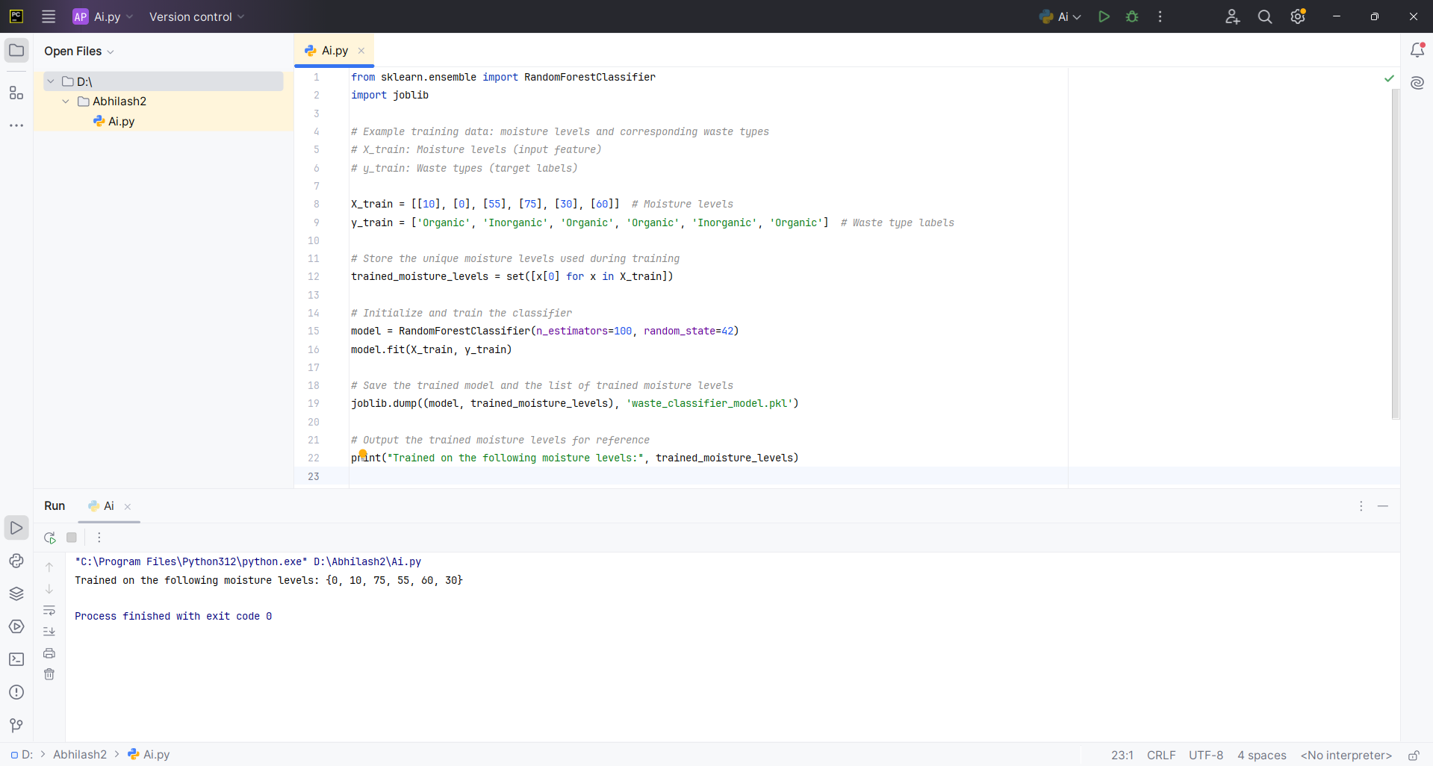
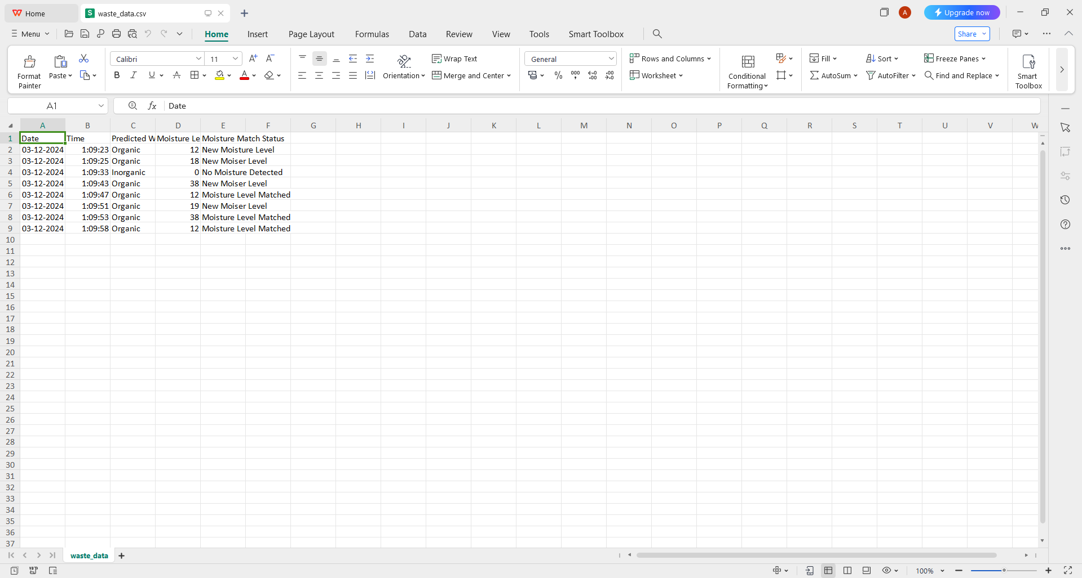
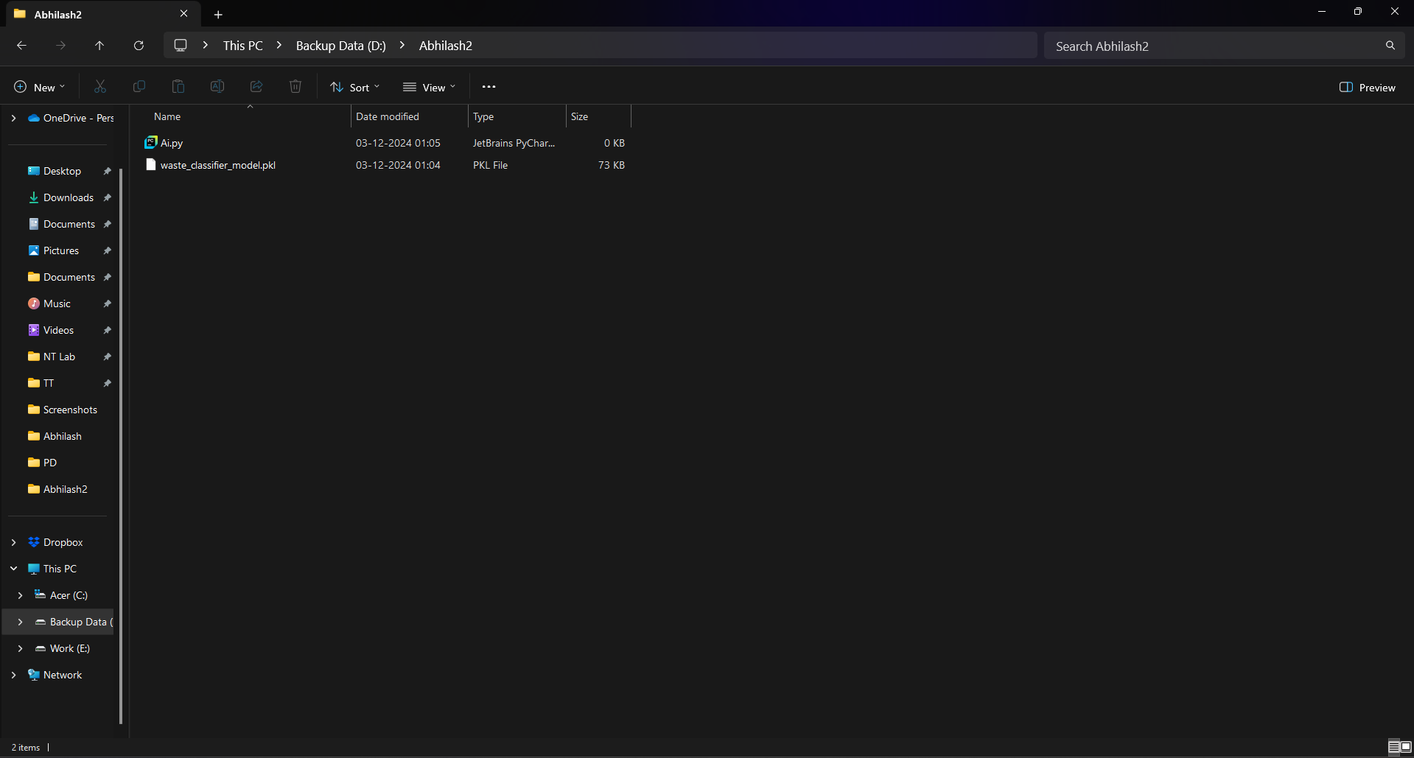
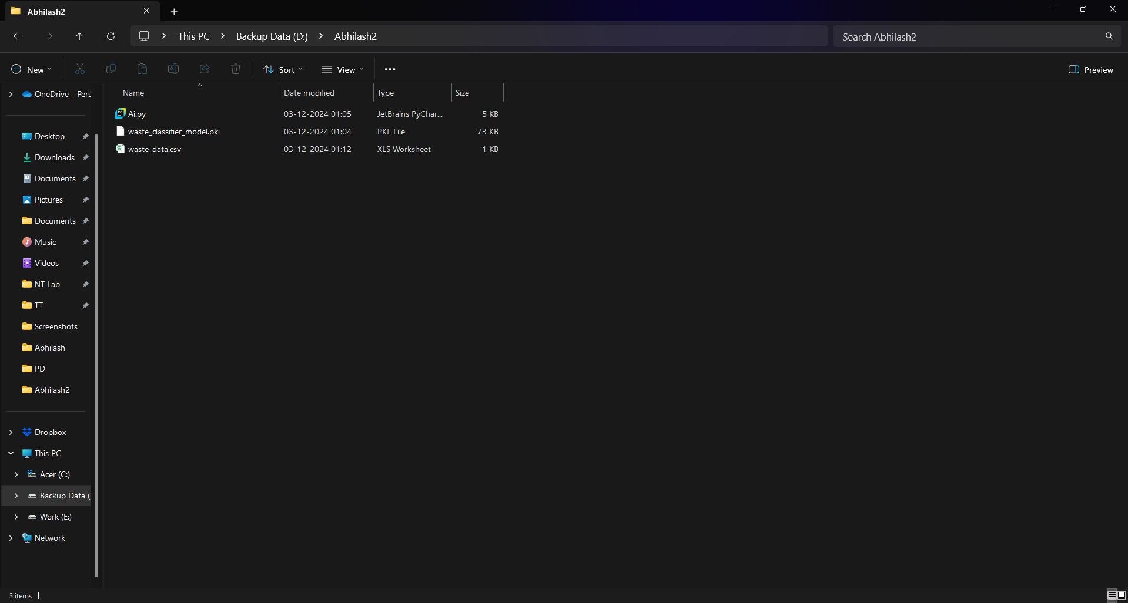
Steps of making
Sensor Output:
Fig: Code for AI part and images of generated files and output

Slide 13
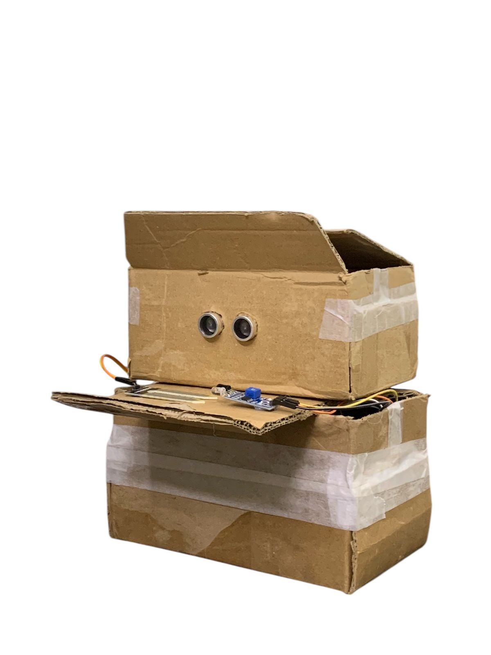
Steps of making
Fig: Finalized Prototype of the SmartBin

Slide 14
Conclusion
The Smart Bin AI project represents a significant step forward in the realm of waste management by integrating advanced technology and artificial intelligence to enhance the efficiency of waste classification. Utilizing an Arduino Uno, the system employs ultrasonic sensors for automatic lid operation, soil moisture sensors to assess the organic content of waste, and infrared sensors for precise object detection.
The incorporation of machine learning algorithms, specifically the Random Forest model, allows for accurate predictions of waste types based on historical data collected from these sensors. This predictive capability not only streamlines the sorting process but also reduces contamination rates, thereby improving recycling efforts and promoting sustainability.
Through careful construction, wiring, and integration of components, we have developed a functional prototype that demonstrates the potential of smart waste management solutions. The project highlights the importance of leveraging technology to address environmental challenges and showcases how innovative approaches can lead to more responsible waste disposal practices.
In summary, the Smart Bin AI project not only enhances operational efficiency in waste management but also contributes to broader sustainability goals, paving the way for smarter cities and a cleaner environment. As we move forward, this project serves as a foundation for further research and development in intelligent waste management systems.

Slide 15
References
Smart Dustbin by using Arduino and ultrasonic sensor (Youtube)- https://www.youtube.com/watch?v=9yrP1CZN3Ds
Smart Bin(Arduino Project Hub)- https://projecthub.arduino.cc/mohammadsohail0008/how-to-make-smart-dustbin-for-your-home-2fd84f
Ultrasonic Sensor(Last Minute Engineers)- https://lastminuteengineers.com/arduino-sr04-ultrasonic-sensor-tutorial/
Soil Moisture Sensor(Circuit Digest)- https://circuitdigest.com/microcontroller-projects/interfacing-soil-moisture-sensor-with-arduino-uno
IR Sensor(Circuit Digest)- https://circuitdigest.com/microcontroller-projects/interfacing-ir-sensor-module-with-arduino
Servo Motor(Last Minute Engineers)- https://lastminuteengineers.com/servo-motor-arduino-tutorial/
“A Brief Study on Random Forest Using Python” Madhav,Shubham Kohli, HimanshuRawat, Priyanshu Joshi Department of Information Technology, Dr. Akhilesh Das Gupta Institute of Technology and Management, New Delhi - https://ijaem.net/issue_dcp/A%20Brief%20Study%20on%20Random%20Forest%20Using%20Python.pdf

Slide 16

Thank You

